Slide 1
PRIO AI CoE: Agentic platform architecture
May 2026

Slide 2
Proposed architecture for delivery of PRIO agentic use cases
External sources (Email)
Token validation
External users
Web Application Firewall (WAF)
Frontend Apps environments
Entra ID (3rd Auth Layer)
Backend Apps environments
Persistent Storage
Only Authenticated Users
Drives the Users to correct App
Access to all Persistent Data Sources
Entra ID Protection (1st Auth Layer)
Storage Accounts
Mitie Azure DataLake
SQL Database
Application Gateways
App 1
App 2
Server 1
Server 2
User Authentication
Azure Managed Redis
Transient Storage
Internal users
Internal network
Server In Detail
Every Server has its Own MI
Entra ID (2nd Auth Layer)
Calls Orchestration through function
FastAPI
Managed Identities
Agent Orchestration Layer
Provide agents with access to persistent storage through tools
Save workflow state + change job status
Server Traces
Microsoft Agentic framework
HITL Request
Orchestration traces
Agents
Foundry
MCP server (FastMCP)
Agent Control Panel
Connect on the Endpoint provided by Tools Registry
Traces consolidation
AI Traces
LLM
Agent A
Tool A
Tool B
Managed Identities
Microsoft agent 365
Application Insights
OpenAI
Agent B
Provides centralized view of tools
Access Layer to communicate with Maximo
Tools registry
Anthropic claude
Use SOP data to Evaluate agent metrics
Agent Evals
Testing datasets
APIM
Maximo
Maximo AWS DB2

Slide 3
Design principles for structuring agents, tools, deterministic steps, and workflows
Agent
Definition:
An agent is an LLM with a system prompt. It may have a set of tools, access to context, memory, and knowledge.
When to build
Input is natural language that requires interpretation
Output requires language composition or synthesis
The task involves judgement under ambiguity and is non-deterministic
The solution path is not fully pre-defined
How to build it well
Keep scope narrow and modular (one responsibility per agent)
Define a strict I/O contract
Provide only necessary tools and context
Constrain behaviour with clear instructions and guardrails
Tool
Definition:
A tool is a functionality an agent can choose to call. It has no prompt, no reasoning, and returns result given inputs
When to build:
An agent needs a capability beyond language alone (API, DB, computation)
The capability should be invoked conditionally based on reasoning
The functionality or capability is a discrete, reusable unit of execution
How to build it well
The tool only executes. Agent decides whether and when to invoke
Design for single responsibility and reuse
Use clear, typed input/output schemas
Ensure error handling
Keep tools stateless and composable
Deterministic step
Definition:
A deterministic step is a plain function (e.g., Python) in the pipeline without LLM involvement. Given the same inputs it always produces the same output
When to build:
The output is a pure transformation of the input
The logic can be expressed as a finite set of rules
The step needs to be performed unconditionally
How to build it well
Keep logic simple, explicit, and fully testable
Maximize use of deterministic steps to reduce cost and increase reliability
Treat it as composable building blocks
Workflow
Definition:
A workflow is the orchestration layer that connects agents, tools, and deterministic steps into a coherent pipeline.
When to build:
Multiple primitives need to be composed (i.e. sequence, parallel, group chat)
The path through the pipeline is conditional or dynamic
The system must pause, resume, or handle long-running tasks
How to build it well:
Start with sequential, explicitly controlled workflows before introducing dynamic multi-agent patterns (e.g., group chat)
Keep agents focused on modular tasks, not entire flows

Slide 4
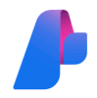


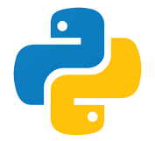
Agentic platform
Agent orchestration layer
Core component
Details
Sends payload to agent A
Agent B receives the result payload
Final agent result
Agent definition and versioning
Agents are defined in YAML and deployed through standard provision script and CI/CD
Agent versioning is managed by Foundry
Agent return the result
Agent request HITL
Sends the new payload to the agent
Tool definition and registry
Tools are registered into Foundry as MCPTool and baked into the agent's definition
Agents
Agent communication
Agent invocation: Foundry agents are invoked through the Azure AI Foundry Agent Framework runtime with support for standardized interoperability patterns
A2A (Agent-to-Agent) protocol enables interoperable communication, delegation, and handoffs across distributed agents
MCP (Model Context Protocol) standardizes tool access, context sharing, and external capability integration
Workflow orchestration supports message passing, agent-as-tool patterns, and multi-agent coordination through Azure AI Foundry
Agent A
Agent B
Provides centralized view of tools
Calls and receives the result
MCP Server (FastMCP)
Tools Registry
Tool A
Tool B
Deploy Agents to Foundry
Deploy MCP Server
Agents definition
Azure Devops
Tools Code

Slide 5
Azure Foundry agent definition
YAML fields | Purpose/description | Example
kind | Defines the type of asset being created in the configuration. | prompt
name | Unique identifier for the agent configuration. | research-agent
model | Specifies which model deployment the agent should use. | gpt-4.1
temperature | Controls randomness vs determinism of responses. | 0.2
instructions | Defines the agent’s role, behavior, and task instructions. | "You are an investment research assistant..."
tools | Configures external tools/APIs the agent can call, including access and approval settings. | MCP server for SAP data
text | Defines the structured output format using a schema for consistent, machine-readable responses. | JSON schema with defined fields
YAML fields
Purpose/description
Example
kind
Defines the type of asset being created in the configuration.
prompt
name
Unique identifier for the agent configuration.
research-agent
model
Specifies which model deployment the agent should use.
gpt-4.1
temperature
Controls randomness vs determinism of responses.
0.2
instructions
Defines the agent’s role, behavior, and task instructions.
"You are an investment research assistant..."
tools
Configures external tools/APIs the agent can call, including access and approval settings.
MCP server for SAP data
text
Defines the structured output format using a schema for consistent, machine-readable responses.
JSON schema with defined fields

Slide 6
CI/CD for Foundry Agents
Agent . Deployment to Azure AI foundry
Agent . PR Validation (every stage blocking)
1. Package agent definitions resolve semver from glt tag
2. Push artifact ACR - blob
1. Source Checkout
3. Source branch
2. YAML Schema Validation
3. Lint naming • Required fields • Model whitelist
Main/release
4. Eval Tests golden prompts • Regression checks
Merge triggers deploy
Dev
Manual approval gate
5. Security Scan secrets • Dependency audit
4. Deploy to foundry project dev branch → dev project main/release → prod project
5. Security Scan secrets • Dependency audit
5. Register agent version versioned entry in Foundry registry previous versions retained for rollback
6. Post – deploy Verification smoke prompts • Otel signals +alerts armed • One click rollback

Slide 7
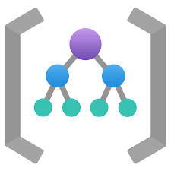
Microsoft Agent Framework orchestrator overview
Core component
Details
Agent Orchestration Layer
1. Orchestrator
Agent Framework SDK provides a pro-code, production-grade foundation for building flexible multi-agent orchestration patterns, from deterministic pipelines to autonomous group collaboration.
Orch-estration through function
User action trigger workflow resume
Update the job status
Microsoft Agentic Framework
Pauses the workflow until user provides feedback
HITL Request
2. Single agent
Foundry agent in Agent Framework SDK initiates a run via .run() which is the single unified call across all agent types
Workflow
Sends payload to agent A
Agent B receives
Final agent result
3. Sequential workflow
Simple workflow: SequentialBuilder
Complex workflow: WorkflowBuilder (graph API) handles complex topologies, such as conditional routing, fan-out, and fan-in by declaring typed executors and edges explicitly
Agent return the result
Sends the new payload to the agent
Agent request HLTL
Foundry agents
4. Group chat
GroupChatBuilder(participants=[agent_a, agent_b, agent_c], max_rounds=10).build() runs all agents in a shared conversation where each sees the others' outputs and a built-in selector decides who speaks next

Slide 8
Logic Apps vs Microsoft Agent Framework as the orchestrator in PRIO (1)
Logic Apps orchestration – static workflows every edge defined at design time
Microsoft Agent Framework – Agentic mesh agents + tools • edges emerge at runtime
Workflow trigger event/schedule
RAG Knowledge
PARSE Intake
Preprocess typed steps . Enrich . transform
DECIDE Classify
SUPERVISIOR Supervisior routing • handoffs
ACTION Action
LLM call returns structured output
Switch
RESOLVE Resolve
Reply Reply
Branch A
Branch B
Branch C
Tools steps
Tools steps
Tools steps
Tool call
SHARED TOOLS • REGISTRY – DISCOVERED • ANY AGENT CAN CALL
Final step amit result/side effect
Create
Query
Search
Resolve
…
every branch enumerated in the workflow definition
adding a branch = editing N workflow assets
LLM is a step • tools are workflow actions
adding an agent = register + add to router • adding a tool = publish to registry

Slide 9
Logic Apps vs Microsoft Agent Framework as the orchestrator in PRIO (2)
Core component
Pros
Cons
Agent Framework
Orchestrates intelligent agents that dynamically collaborate, reason, and evolve workflows at runtime.
First-class agents: Treats agents as independent, stateful actors rather than isolated LLM or function calls
Agent-to-agent interaction: Enables direct, iterative collaboration (e.g., critique loops, debate, cooperative problem solving)
Agent mesh" Supports dynamic coordination across multiple agents without a single controlling workflow
Runtime-driven execution: Execution paths are determined dynamically based on agent outputs and evolving state
Iterative reasoning: Natively supports refine–critique–converge loops without rigid workflow definitions
Memory: Provides session-based state and memory patterns to maintain and reuse context across multi-step interactions
Workflow complexity: Modular, graph-based orchestration scales naturally as workflows become more dynamic and multi-agent
Developer control: Code-first architecture enables fine-grained control over orchestration, routing, and extensibility
Infrastructure: requires the team to manage hosting, scaling, resiliency, monitoring, and operational concerns
Enterprise integration: Does not provide a native enterprise connector ecosystem, requiring teams to build and maintain integration layers themselves
Resilience: Retry and resilience strategies are more code-driven and require additional implementation/configuration compared to Logic Apps’ built-in workflow policies
Logic App
Orchestrates predefined workflows that reliably execute structured processes and system integrations.
Developer control: Low-code visual development accelerates delivery for simple workflows and reduces engineering effort for common automation patterns
Orchestration: strong for deterministic, predefined workflows with clear execution paths
Infrastructure: Fully managed platform with built-in scaling and reliability etc., enabling teams to deploy workflows quickly with minimal infrastructure overhead
Enterprise integration: Extensive library of prebuilt enterprise connectors enables rapid integration with Microsoft and third-party systems
Resilience: provides built-in retry, timeout, and exception-handling policies as native workflow capabilities, simplifying operational resilience
First-class agents: Agents are treated as isolated LLM or function calls rather than independent, stateful entities
Agent-to-agent interaction: Interactions are indirect and must be explicitly coordinated through workflow logic
Agent mesh Relies on a centralized workflow controller, limiting mesh-style coordination
Runtime-driven execution: Execution paths must be defined upfront, limiting adaptability
Iterative reasoning: Iteration must be explicitly managed, making convergence workflows harder to implement
Memory: Shared memory and context coordination must be implemented manually via workflow logic and external storage
Workflow complexity: Complexity grows rapidly as workflows become more dynamic and multi-agent
Developer control: Dynamic behavior and custom execution patterns are difficult to implement cleanly

Slide 10
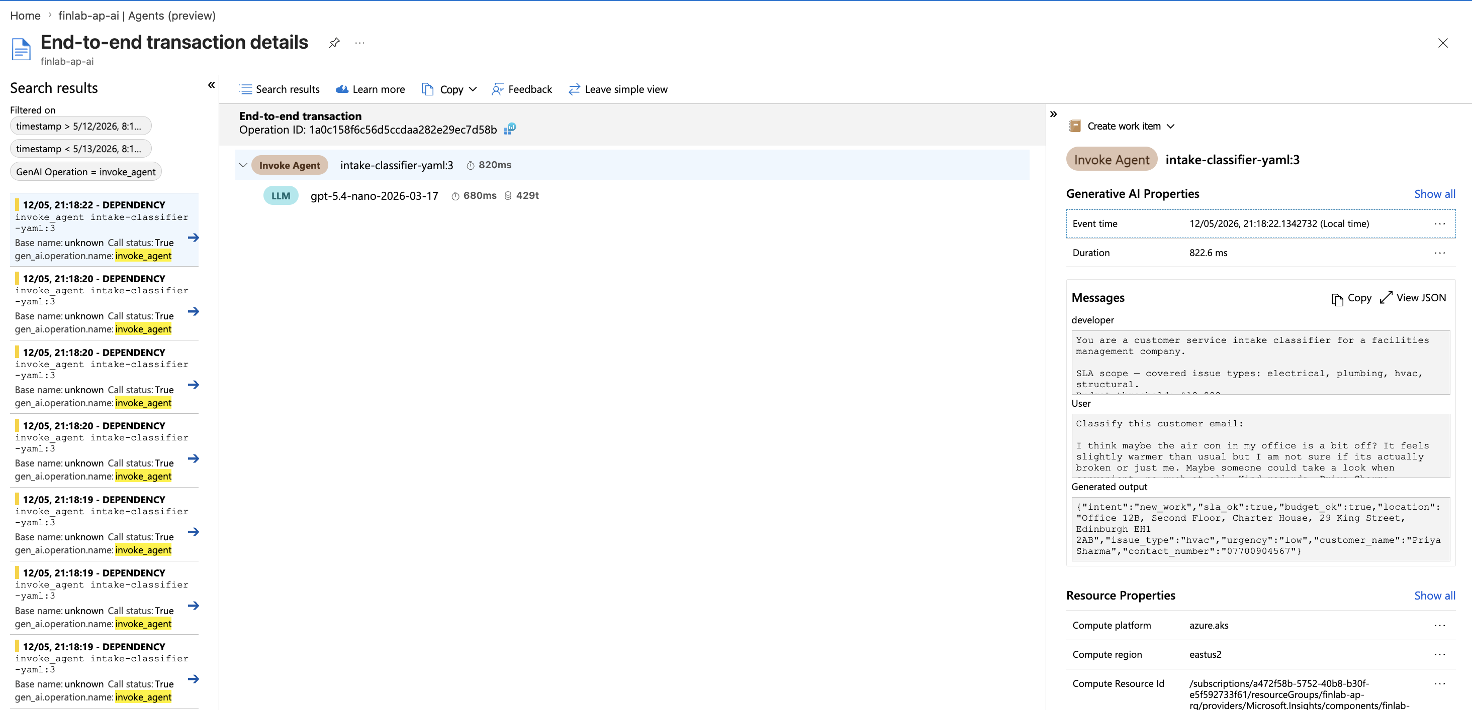
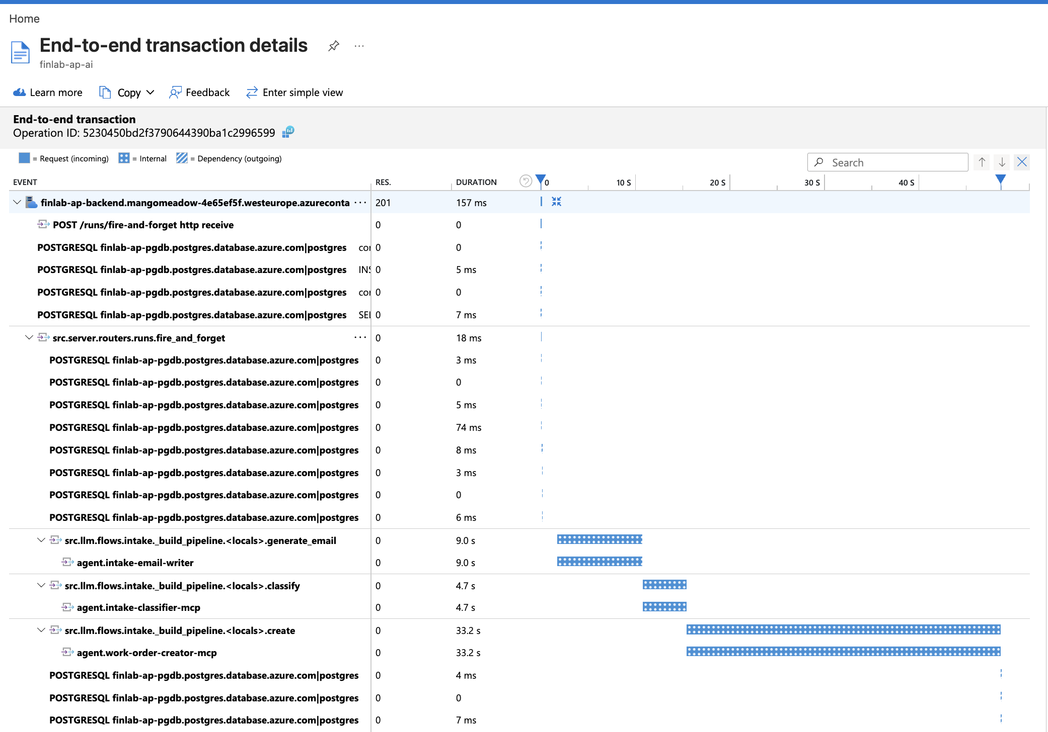
Control pane - observability
Agent traces
Core component
Details
1. Traces
Application Insights is set up for both agent and workflow traces, including input, output, token sage, event run time etc.
2. Live dashboard
Application Insights will be used to provide live dashboards across all agents, enabling visibility into error rates (by tool or model), number of runs, and token consumption (input/output) by model.
Foundry will be leveraged to deliver agent-level monitoring, including live dashboards on estimated cost, token usage, error rates, and run volumes.
Workflow traces
3. Agent evaluation
Offline: save source of truth in blob storage and register in Foundry. Use evaluate() function supported by foundry to spin up custom evaluator for each agent
Online: Foundry supports built-in evaluators on relevance, coherence, grounding etc.

Slide 11
System integration
Updates the job workflow state
Core component
Every new email is sent to the server
Agent Orchestration Layer
Details
External Sources (Email)
Calls Orchestration through function
User action trigger workflow resume
Update the job status
1. Ingestion Layer
Handles incoming requests from external sources (e.g., email, apps) via APIs. Validates inputs and routes them into the orchestration flow.
Checks for pending HITL request
FastAPI
Pauses the workflow until user provides feedback
SQL Database
Reply to HITL requests
Microsoft Agentic Framework
HITL Request
Workflow
App
Final agent result
2. Orchestration Layer
Coordinates the end-to-end workflow using the agent framework. Manages state, handles pauses (e.g., human-in-the-loop), and controls execution logic
Sends payload to agent A
Agent B receives
Agent request HLTL
Agent return the result
Sends the new payload to the agent
Foundry
3. Agent & Tools Layer
Agents execute tasks and interact with registered tools via MCP servers. Enables modular, reusable capabilities and dynamic tool calling
Agents
Agent A
Agent B
Provides centralized view of tools
Calls and receives the result
MCP Server (FastMCP)
4. Persistence & State Management
Stores workflow state, job status, and results in the database. Ensures reliability, traceability, and resumability of long-running processes
Tools Registry
Tool A
Tool B

Slide 12
Data
Core component
Details
Persistent Storage
1. Operational data
Operational business data is stored and managed in SQL Server as the system of record.
2. Knowledge base
Create an AI Search index (define fields, vector algorithm, query-time vectorizer and semantic ranker)
Create an indexer with a skillset (connect blob/SharePoint as data source, chunk and embed documents on a schedule)
Create a Knowledge Base object that wraps the index as a named knowledge source with endpoint exposed
Add the KB's MCP URL to the agent's tools, and the agent autonomously calls knowledge_base_retrieve when it needs to look something up.
Storage Accounts
Mitie Azure DataLake
SQL Database
3. Agent/workflow context
Individual agent: agent within workflow automatically has memory. Standalone agent’s short-term memory is managed by agent session.
Workflow shared state: ctx.set_state(key, value) / ctx.get_state(key) inside any executor gives all nodes in the graph access to common data within a single run
4. Fabric data connection
TBD

Slide 13
Security
Core component
Details
MCP Server (FastMCP)
1. Agent Identity
Each hosted agent deployed through Foundry is automatically assigned a dedicated Microsoft Entra ID identity at deployment time. The identity is platform-managed and used by the agent runtime to authenticate against MCP servers, Azure services, and downstream tools without storing secrets
Managed Identities
Tool A
Tool B
2. Managed Authentication Flow
When an agent invokes a tool, Foundry performs an OAuth token exchange with Microsoft Entra ID and retrieves a scoped access token for the target resource. Authentication and token lifecycle management are handled by the platform automatically
3. RBAC & Access Governance
Access to MCP tools, Azure resources, and external systems is controlled through RBAC assignments tied to the agent identity. Permissions are scoped per agent and enforced at runtime to support least-privilege access and auditability
Agents definition
Versioning
Azure Devops
Versioning
Tools Code
4. Delegated / OBO Access
Foundry supports delegated access using OAuth On-Behalf-Of (OBO) flows, allowing agents to access user-specific resources with the user’s delegated permissions while preserving enterprise security controls and policy enforcement
5. Tool Authentication
MCP servers validate incoming Entra ID tokens (JWT) by verifying issuer, audience, and signature. The agent identity (client ID / object ID) is extracted from the token and checked against allowed identities or roles to determine if the agent is authorized to execute the requested tool
Service Principals

Slide 14
Microservice
Core component
Details
Data Sources
1. Input Sources
Requests originate from external systems (e.g., email, webhooks) or internal applications (web/mobile). Traffic is routed through the API layer, which acts as the single entry point for all interactions.
External Sources (Email)
Entra ID protection
2. API & Processing Layer
Built using FastAPI (Python), responsible for handling incoming requests and orchestrating business logic.
Validates and processes requests
Integrates with downstream services and data sources
Acts as the orchestration layer for agent-driven workflows
Validates all requests
Server
Use as transient storage
3. Authentication (Identity)
Entra ID secures the API using OAuth2 / JWT-based authentication.
Validates tokens (issuer, audience, expiration, scopes)
Enforces secure, authenticated access to endpoints
Built with
Deploys to
4. Authorization & Validation
Controls what authenticated clients are allowed to do and ensures data integrity.
RBAC enforces least-privilege access to endpoints and resources
Pydantic models validate request/response schemas and data contracts
Audit logging tracks access and system interactions
App
FastAPI
Container Apps Environment
Azure Managed Redis
Orchestration and Agents
5. Compute & Caching
Service is containerized and deployed on Azure Container Apps for scalable execution.
Supports elastic scaling and isolated runtime environments
Azure Managed Redis used for caching, session state, and transient storage
Improves performance and reduces latency for repeated operations
6. Common Layer (Cross Microservices)
Shared platform components ensure consistency and reusability across services.
Dependency Injection layer for shared services (logging, config, clients)
Common SDKs and libraries reused across microservices
Centralized configuration and observability standards

Slide 15
CI/CD - BE
BE . Deployment (triggered on merge)
BE . PR Validation (every stage blocking)
1. Package agent definitions resolve semver from glt tag
2. Push to ACR
1. Source Checkout
3. Source branch?
2. Build and compile uv sync → frozen
3. Lint and type check ruff mypy
Main/release
4. Test and coverage pytest >= 90%
Dev
Manual approval gate
5. Security Scan SAST + dependency audit
4. Deploy to Environment dev branch → dev env main/release → prod env
All PR gates green required for merge
5. Container startup alembic upgrade head then uvicorn
6. Post – deploy Verification health • Postman API checks • OTel signals • alerts armed • one – click rollback

Slide 16

Frontend
Core component
Details
1. User Access Layer
Users access the platform through a unified frontend interface (single entry point), exposed via the Application Gateway.
Provides a consistent entry point across all workflows
Routes user interactions securely to backend services
Users Auth-entication
Deployed to
Entra ID Protection
Container Apps Environments
2. Authentication & Identity
User authentication is handled via Microsoft Entra ID using OAuth2 flows.
Issues bearer tokens for authenticated sessions
Enables secure access to protected backend APIs
Connect to
Routes the user
Request with bearer token from entra ID
3. Application Layer
Built using Next.js, the frontend acts as a lightweight orchestration layer for user interactions.
Renders UI and manages client-side state
Calls backend APIs using authenticated requests
Aggregates multiple backend workflows into a single user experience
Enables human-in-the-loop (HITL) interactions where required
Users
Application Gateways
App
Server
Built ID
4. Experience Layer
Provides a unified interface to access multiple workflows and services.
Consolidates different tools and agent workflows into one UI
Simplifies navigation and user experience
Supports modular UI components for different use cases
Next.js
5. Compute & Hosting
Frontend is deployed on Azure Container Apps for scalable and reliable delivery.
Handles frontend rendering
Scales based on user demand

Slide 17
CI/CD - FE
BE . Deployment (triggered on merge)
FE . PR Validation (every stage blocking)
1. Package and Sign Docker build from base image . cosign
2. Push to ACR
1. Source Checkout
3. Source branch?
2. Build and compile npm ci • next build
3. Lint and type check ESLint • Prettier • tsc
Main/release
4. Test and coverage Jest >= 70%
Dev
Manual approval gate
5. Security Scan SAST + dependency audit
4. Deploy to Environment dev branch → dev env main/release → prod env
All PR gates green required for merge
5. Container startup Next.js boot
6. Post – deploy Verification health • smoke • OTel signals + alters armed • one – click rollback

Slide 18
CI/CD – Base Image
Base Image Pipeline (runs centrally, on CVE / Schedule)
1. Build base image
2. Patch CVEs
3. Scan base image
4. Sign image cosign
5. Push to ACR
6. Version and tag

